Slide 1
Thread Concept

Slide 2
Introduction
Earlier the operating system provides the concept of single thread of control-that is a process.
But now most modern operating systems provide features enabling a process to contain multiple threads of control.
Programming languages such as C and C++ are single threaded languages and languages like java and C# are multi threaded.

Slide 3
Introduction
Thread is a basic unit of CPU utilization.
It comprises of thread ID, program counter a register set and a stack.
It shares with other threads belonging to the same process its code section, data section, and other operating-system resources, such as open files.
The thread is sometimes called as a Light Weight Process(LWP), shares many attributes of a process

Slide 4
Introduction
Threads are scheduled on processors and each thread can execute a set of instructions independent of other processes and threads.
However threads are not meant to exist alone, they normally belong to processes (HWP).

Slide 5
Thread Concept
Depending on the thread implementation for the particular platform, threads may be managed by the operating system or by the user application that creates them.
Win32 threads-Windows
C-threads- are created from thread library in Mach microkernel
POSIX threads-Pthreads

Slide 6

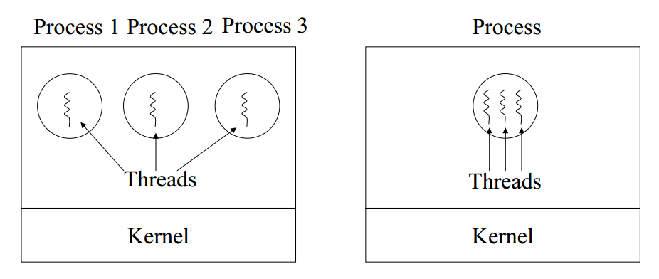
Process/Threads

Slide 7
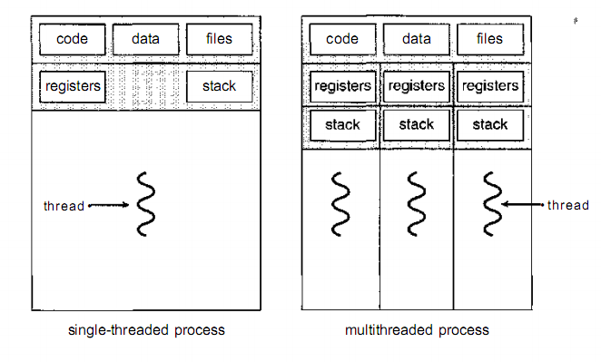
Thread concept

Slide 8
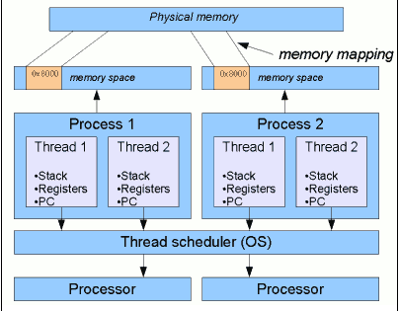
Thread/Process Relationship

Slide 9
Threads/Processes
Single process, single thread
– MS DOS, old MAC OS
Single process, multiple threads
Multiple processes, single threads
– Traditional UNIX
Multiple processes, multiple threads
– Modern UNIXes (Solaris et al.) and Windows 2000

Slide 10
Benefits of Multithreading
Increased concurrency (i.e., interleave blocking operations; e.g., computation and I/O in one process)
Simplified programming model
Increased responsiveness (balance of I/O and
compute-bound threads)
Resource sharing (i.e., leads to less memory being used)
Economy (i.e., cheaper to create threads)
Potential performance gain: Utilization of multi-CPU

Slide 11
Life Cycle of a thread
When a process contains a multiple threads of control ,we can view each thread as transition between series of discrete Thread states.
Example Java Threads states:
  Born -Dead
  Ready -Blocked
  Running -Waiting
  Sleep -yield

Slide 13
Thread Types
Kernel-Level Threads
User-level Threads

Slide 14
User-Level Threads
The user-level threads perform threading operations in user-space, meaning that threads are created by runtime libraries that cannot execute privileged instructions or access kernel primitives directly.
In this level, the kernel is not aware of the existence of threads.

Slide 15
User-level Threads
The kernel is not aware of thread activity but it is still managing process activity.
ULTs can run on any OS -- Only needs a thread library.

Slide 16
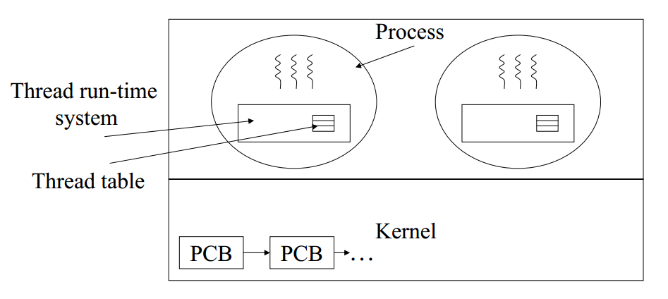
User-level Threads

Slide 17
Advantages
Can be supported on operating systems that do not support threads inside the kernel
Thread context switch is much faster then process context switch
– No kernel mode switch required
– Only registers are saved/loaded
– Thread may voluntarily yield (local call)
Consequently, thread scheduling is very efficient
Better scalability (i.e., more threads, since no kernel access and data structures are required)

Slide 18
Kernel-Level Threads
In this level, All thread management is done by kernel No thread library but an API (system calls) to the kernel thread facility exists.
The threads are scheduled by the kernel.
The major difference can be seen when using multiprocessor systems, user threads completely managed by the threading library can't be run in parallel on the different CPUs, Since kernel threads use the kernel scheduler, different kernel threads can run on different CPUs.

Slide 19
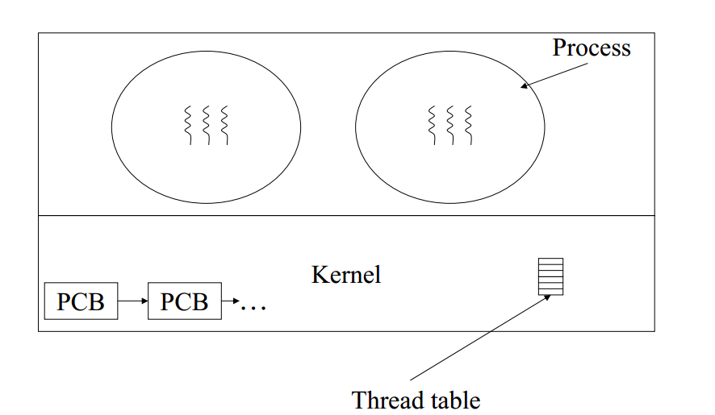
Kernel-Level Threads

Slide 20
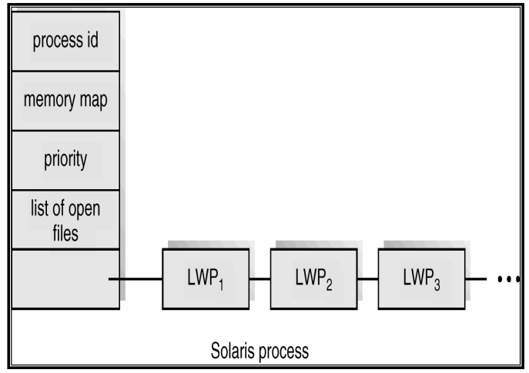
Solaris Example

Slide 21
Thread Models
To exhibit the relationship among between user-level and kernel level threads there are three different models:
  Many-to-One Model
  One-to One Model
  Many-to-Many Model

Slide 22
Many-to One Model
Maps many user-level threads to one kernel level thread.
Thread management is done by thread library in user space so it is efficient.
Only one thread can access the kernel at a time, multiple threads are unable to run in parallel on multiprocessors.
Example: Green threads—a thread library available for Solaris

Slide 23
One-to-One Model
Maps each user thread to a kernel thread.
It provides more concurrency than the many-to-one model by allowing another thread to run when a thread makes a blocking system call; it also allows multiple threads to run in parallel on multiprocessors.
Linux, along with the family of Windows operating systems—including Windows 95, 98, NT, 2000, and XP—implement the one-to-one model.

Slide 24
Many-to-Many Model
Multiplexes many user-level threads to a smaller or equal number of kernel threads.
It is a compromise between the last two models.

Slide 25
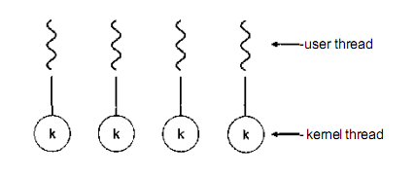
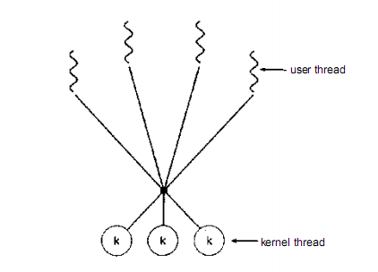
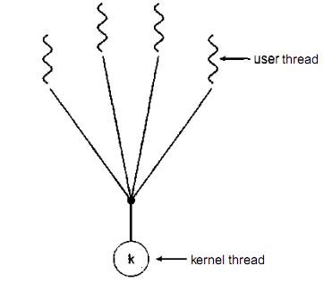
Models

Slide 26
Thread Libraries
Thread libraries provide the means of thread generations and management as APIs in the development of multithreaded applications.
The implementation of such libraries are performed via two principal approaches: user and kernel levels.

Slide 27
Thread Libraries
POSIX Pthreads
Win32
Java Threads

Slide 28
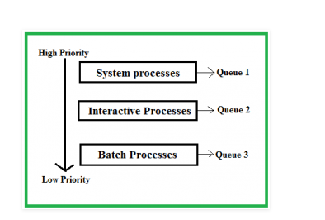
Multilevel Queue (MLQ) CPU Scheduling
Ready Queue is divided into separate queues for each class of processes. For example, let us take three different types of process System processes, Interactive processes and Batch Processes.

Slide 29
Scheduling among the queues
Fixed priority preemptive scheduling method – Each queue has absolute priority over lower priority queue
Time slicing – In this method each queue gets certain portion of CPU time and can use it to schedule its own processes.

Slide 30
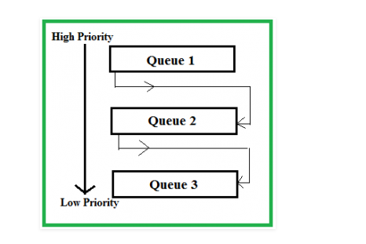
Multilevel Feedback Queue Scheduling (MLFQ) CPU Scheduling

Slide 31
Multilevel Feedback Queue Scheduling (MLFQ) CPU Scheduling
Consider a system which has a CPU bound process, which requires the burst time of 40 seconds. The multilevel Feed Back Queue scheduling algorithm is used and the queue time quantum ‘2’ seconds and in each level it is incremented by ‘5’ seconds. Then how many times the process will be interrupted and on which queue the process will terminate the execution?

Slide 32
Real-Time Systems
A real-time system is one whose correctness depends on timing as well as functionality.
Real-time systems have very different requirements, characterized by different metrics:
timeliness ... how closely does it meet its timing requirements (e.g. ms/day of accumulated tardiness)
predictability ... how much deviation is there in delivered timeliness
And we introduce a few new concepts:feasibility
hard real-time ... there are strong requirements that specified tasks be run a specified intervals (or within a specified response time). Failure to meet this requirement (perhaps by as little as a fraction of a micro-second) may result in system failure.
soft real-time ... we may want to provide very good (e.g. microseconds) response time, the only consequences of missing a deadline are degraded performance or recoverable failures.

